Slide 1
Splay Tree
Parinya Sanguansat

Slide 2
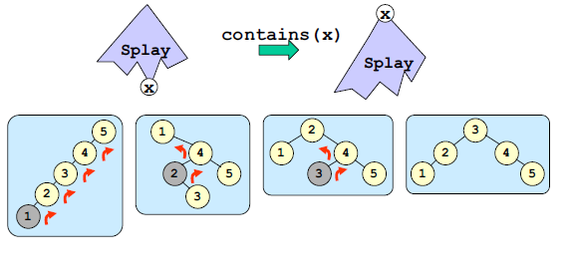
Splay Tree
Splay tree is a self-adjusting binary search tree with the additional property that recently accessed elements are quick to access again.
Rotate the last searched node to root (Splay)
Self-Adjust after all services: add remove contains and get

Slide 3
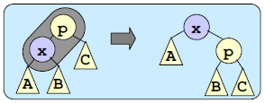
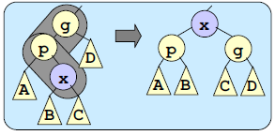
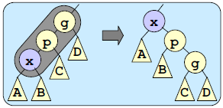
Splay Tree: Tree rotation
Zig
Zig-Zag
Zig-Zig

Slide 4
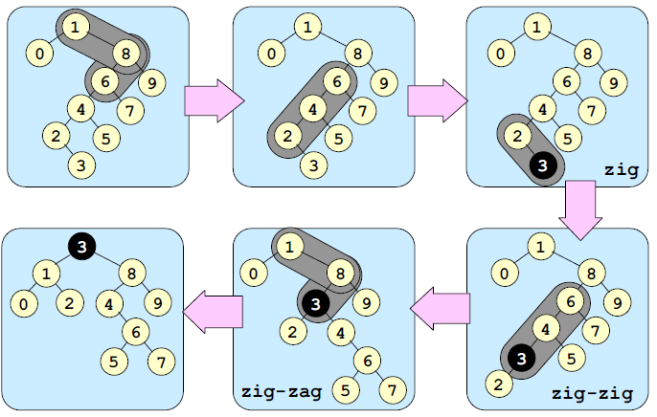
Splay Tree: Bottom-Up Splay
Move to root

Slide 5
Splay Tree: Top-Down Splay
Bottom-up splay trees are hard to implement
Zig
Cut the first branch
Link left or right
Zig-Zig
Cut the second branch
Rotate the cut parent up
Link left or right
Zig-Zag
Cut the first branch
Link left or right

Slide 6
Splay Tree: Top-Down Splay
Zig
X
Y
L
R
L
A
R
Y
B
A
X
B

Slide 7
Splay Tree: Top-Down Splay
Zig-Zig
X
Z
L
R
L
A
R
Y
C
Z
B
Y
A
X
B
C

Slide 8
Splay Tree: Top-Down Splay
Zig-Zag
X
Y
L
R
L
R
Y
C
A
Z
B
A
Z
X
B
C

Slide 9
Example 1: Top-Down Splay (Access 18)
12
12
5
25
5
25
12
15
20
20
30
zig-zag
20
30
zig-zig
5
13
18
25
15
24
15
24
16
24
30
13
18
13
18
zig
16
16
18
12
20
12
18
20
5
15
25
Reassemble
5
15
16
25
13
16
24
30
13
24
30

Slide 10
Example 2: Top-Down Splay (Access C)
H
B
F
B
E
F
F
I
A
E
H
A
D
H
B
G
zig-zig
zig-zag
D
G
I
C
G
I
A
E
C
D
zig-zig
C
C
B
F
B
C
F
Reassemble
A
D
H
A
D
H
E
G
I
E
G
I

Slide 11
SplayTree: splay
private void splay(object e)
{
Node header = new Node(null, null, null);
Node l, r, t; l = r = header; t = root;
for (; ; ) {
if (((IComparable)e).CompareTo(t.e) < 0) {
if (t.left == null) break;
if (((IComparable)e).CompareTo(t.left.e) < 0) {
t = rotateLeftChild(t);
if (t.left == null) break;
}
r.left = t; r = t; t = t.left;
}
else if (((IComparable)e).CompareTo(t.e) > 0) {
if (t.right == null) break;
if (((IComparable)e).CompareTo(t.right.e) > 0) {
t = rotateRightChild(t);
if (t.right == null) break;
}
l.right = t; l = t; t = t.right;
}
else break;
}
l.right = t.left; r.left = t.right;
t.left = header.right; t.right = header.left;
root = t;
}

Slide 12
Splay Tree: add
Add x
Add x by BSTree.add(x)
Splay node x to root node

Slide 13
SplayTree: add
public override void add(object e)
{
if (root == null) {
root = new Node(e, null, null);
SIZE++; return;
}
splay(e);
int cmp = compareTo(e, root.e);
Node n = new Node(e, null, null);
if (cmp < 0) {
n.left = root.left;
n.right = root;
root.left = null;
}
else {
n.right = root.right;
n.left = root;
root.right = null;
}
root = n; SIZE++;
}

Slide 14
Splay Tree: remove
Remove x
Find node x
Splay node x to root node
Get min node of left or right subtree
Splay min node to root node of that subtree
Connect root node to another subtree

Slide 15
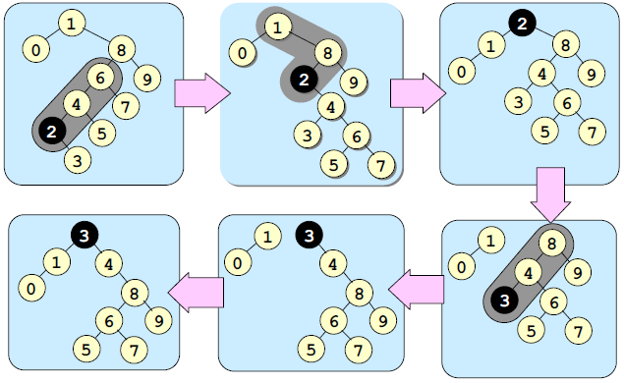
Splay Tree: remove

Slide 16
SplayTree: remove
public override void remove(object e)
{
splay(e);
if (compareTo(e, root.e) != 0)
return;
if (root.left == null)
root = root.right;
else
{
Node x = root.right;
root = root.left;
splay(e);
root.right = x;
}
SIZE--;
}

Slide 17
SplayTree: contains
bool contains(object e)
public override bool contains(object e)
{
Node node = getNode(root, e);
if (node == null) return false;
splay(x.e);
return true;
}

Slide 18
SplayTree: getMin and getMax
object getMin()
object getMax()
public override object getMin()
{
Node x = root;
if (root == null) return null;
while (x.left != null)
x = x.left;
splay(x.e);
return x.e;
}
public override object getMax()
{
Node x = root;
if (root == null) return null;
while (x.right != null)
x = x.right;
splay(x.e);
return x.e;
}

Slide 19
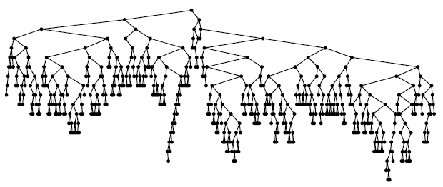
Splay Tree: Complexity
The tree is not guaranteed that will be small depth
Ex: add 1 to 500
Quick access for recent data
No extra information
The total cost of performing the sequence of m operations is O(m log n)
The average cost of each operation is O(log n)

